Slide 1
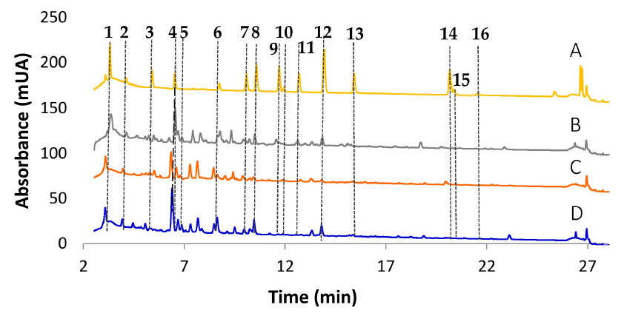
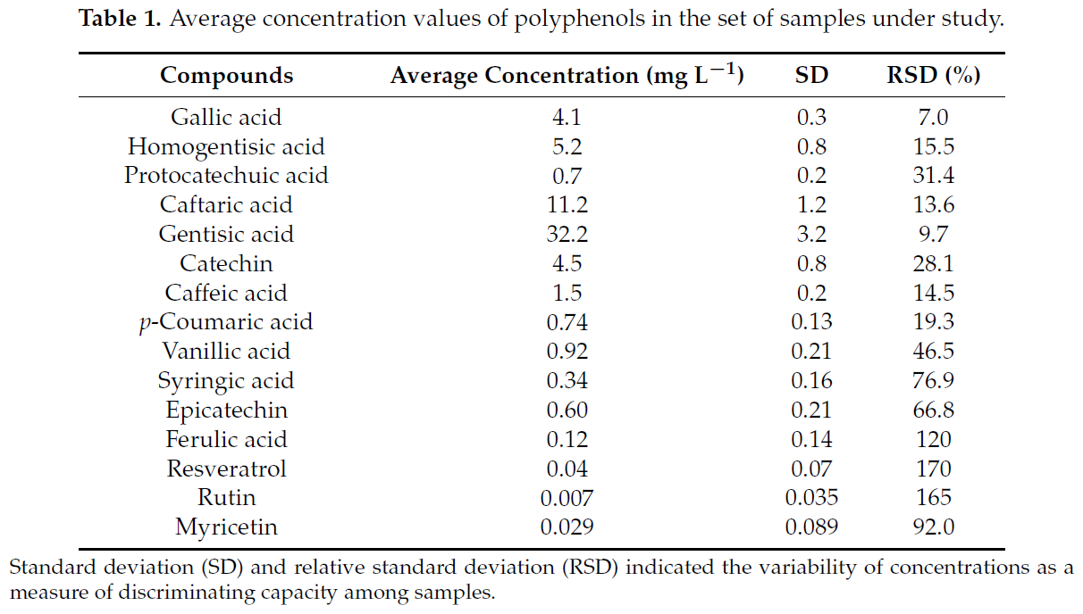
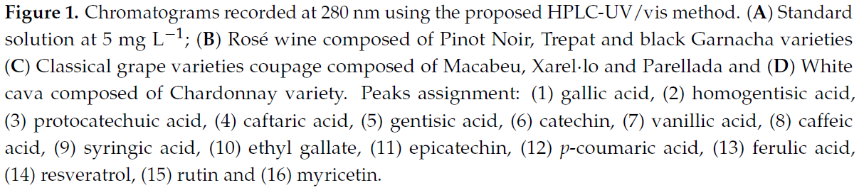

Izquierdo-Llopart, A., & Saurina, J. (2019). Characterization of Sparkling Wines According to Polyphenolic Profiles Obtained by HPLC-UV/Vis and Principal Component Analysis. Foods, 8(1), 22.
Characterization of Sparkling Wines According to Polyphenolic Profiles Obtained by HPLC-UV/Vis and Principal Component Analysis
UV-VIS was used to determine the polyphenols in a sparkling wine
Compounds were separated by an elution method on a C18 column by increasing the percentage or methanol
After that, the samples were degasified and filtered through a nylon membrane.
As a result of this test, the authors can describe which type of wine they were testing and what elements each of it has. They present the results in a graph and table.

